Slide 1
Microservice Design Patterns

Slide 2
Service Discovery

Slide 3
What is Service Discovery?
The Service Discovery mechanism helps us know where each instance is located.
A Service Discovery component acts as a registry in which the addresses of all instances are tracked.
The instances have dynamically assigned network paths.
Consequently, if a client wants to make a request to a service, it must use a Service Discovery mechanism.

Slide 4
The Need for Service Discovery
Dynamically determining the location of an application service isn’t a trivial matter.
Things become more complicated when we consider an environment where we’re constantly destroying and distributing new instances of services.
This may well be the case for a cloud-based application that’s continuously changing due to horizontal autoscaling to meet peak loads, or the release of a new version.
Hence, the need for a Service Discovery mechanism.

Slide 5
How Does Service Discovery Works?
Service Discovery handles things in two parts.
First, it provides a mechanism for an instance to register and say, “I’m here!”
Second, it provides a way to find the service once it has registered.

Slide 6
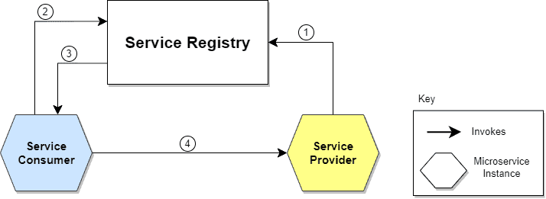
Communication flow between Service Consumer and Service Provider.
The location of the Service Provider is sent to the Service Registry (a database containing the locations of all available service instances).
The Service Consumer asks the Service Discovery Server for the location of the Service Provider.
The location of the Service Provider is searched by the Service Registry in its internal database and returned to the Service Consumer.
The Service Consumer can now make direct requests to the Service Provider.

Slide 7
Service Discovery patterns
Client‑Side Discovery
Server‑Side Discovery

Slide 8
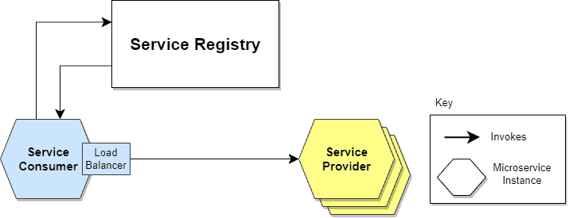
Client-Side Service Discovery
Service Consumer is responsible for determining the network locations of available service instances and load balancing requests between them.
The client queries the Service Register.
Then the client uses a load-balancing algorithm to choose one of the available service instances and performs a request.

Slide 9
Advantage & Disadvantage of Client Side Discovery
It’s an advantage because it saves an extra hop that we would’ve had with a dedicated load balancer.
It’s a disadvantage because the Service Consumer must implement the load balancing logic.
Client-Side Discovery logic must be implemented for each programming language and framework used by the Service Consumers.

Slide 10
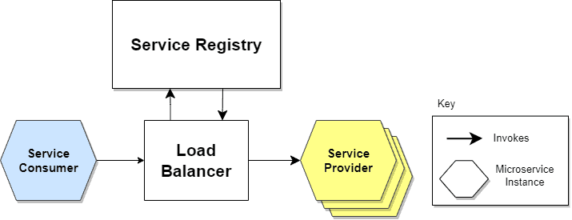
Server-Side Service Discovery
It uses an intermediary that acts as a Load Balancer.
The client makes a request to a service via a load balancer that acts as an orchestrator.
The load balancer queries the Service Registry and routes each request to an available service instance.

Slide 11
Advantage & Disadvantage of Server Side Discovery
As a dedicated actor, the Load Balancer, does the job of load balancing. This is the main advantage of this approach. Indeed, creating this level of abstraction makes the Service Consumer lighter, as it doesn’t have to deal with the lookup procedure. As a matter of fact, there’s no need to implement the discovery logic separately for each language and framework that the Service Consumer uses.
Disadvantage is that we must set up and manage the Load Balancer, unless it’s already provided in the deployment environment.

Slide 12
How does this registration and de-registration operation of microservice in Service Registry take place?
The Service Register is a crucial part of service identification.It’s a database containing the network locations of service instances.
A Service Registry must be highly available and up-to-date.
Clients can cache the network paths obtained from the Service Registry; however, this information eventually becomes obsolete, and clients won’t reach the service instances.
Consequently, a Service Registry consists of a cluster of servers that use a replication protocol to maintain consistency.

Slide 13
Service Registration Options
Self-Registration
Third-party Registration

Slide 14
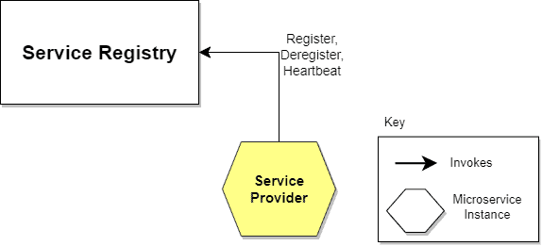
Self-Registration
When using the self-registration model, a service instance is responsible for registering and de-registering itself in the Service Registry.
In addition, a service instance sends heartbeat requests to keep its registration alive.
This model is preferred because of its simplicity and independence. It won’t require any other system entities to proceed. But, as it integrates the service instance into Service Registry, things become complex. It asks for registration code implementation for every used framework and language.

Slide 15
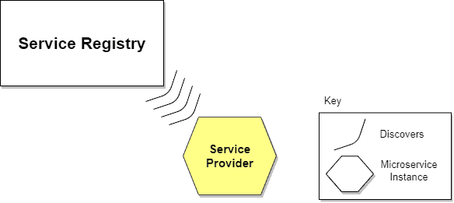
Third-party Registration
Service instances aren’t responsible for registration in the Service Registry. Instead, another system component known as the Service Register is responsible for registration.
The Service Register keeps track of changes to running instances by polling the deployment environment or subscribing to events.
When it detects a newly available service instance, it records it in its database.
The Service Registry also de-registers terminated service instances.
Advantages is that services are decoupled from the Service Registry. There’s no need to implement service registration logic for each programming language and framework. Instead, the registration of service instances is managed centrally within a dedicated service. Disadvantage of this model is that, unless it’s embedded in the deployment environment, it’s yet another highly available system component that needs to be set up and managed.

Slide 16
Circuit Breaker Pattern

Slide 17
What’s the Circuit Breaker Pattern?
The circuit breaker pattern is a design pattern used to detect and manage failures gracefully in a distributed system.
It monitors communication between microservices and temporarily halts requests to a failing service, giving it time to recover.
This helps avoid further strain on the failing service and prevents a domino effect.
It helps us determine whether the downstream service functions correctly by monitoring service interactions.
If not, the circuit breaker trips and subsequent requests are either rejected or redirected, ensuring system stability.

Slide 18
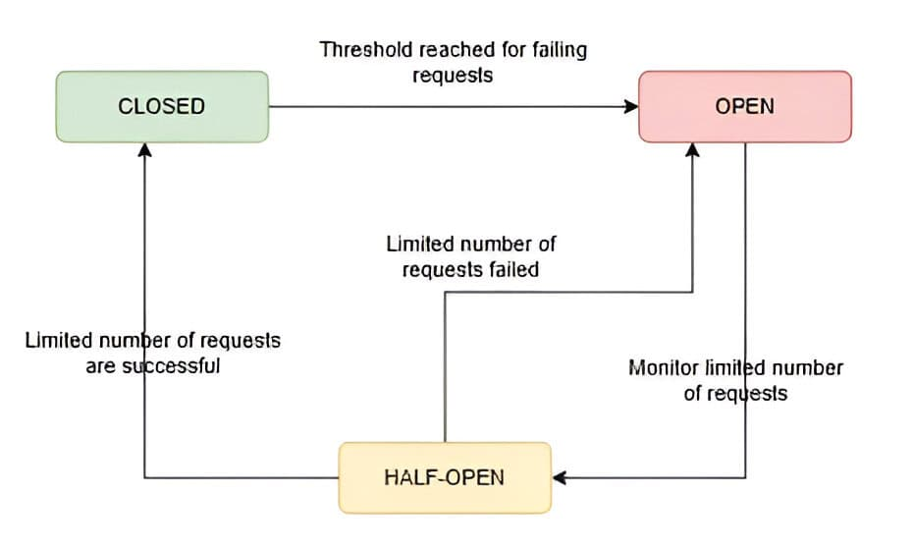
How Does the Circuit Breaker Work?
The circuit breaker operates in three states: closed, open, and half-open.
The circuit breaker starts in the closed state, allowing requests to pass through to the service. Meanwhile, as requests are processed, the circuit breaker monitors for failures. If the number of failed requests exceeds a predefined threshold within a specific time window, the circuit breaker transitions to the open state.
After a timeout period, the circuit breaker moves to the half-open state. In this state, a limited number of requests are allowed to pass through. If these requests succeed, the circuit breaker returns to the closed state. However, if these requests fail, the circuit breaker remains in the open state for another timeout period. This prevents the system from sending further requests to the failing service.
Finally, if the limited number of requests in the half-open state are successful, the circuit breaker transitions back to the closed state.
By monitoring and transitioning between these states, we can ensure minimal disruption during service failures.

Slide 19
Implementation of Circuit Breaker
Netflix’s Hystrix was a popular library for this purpose, though it has since been deprecated. However, alternatives like Resilience4j and Spring Cloud Circuit Breaker are now commonly used. These libraries allow developers to configure the pattern with minimal effort, including parameters like failure thresholds, timeout durations, and recovery mechanisms.

Slide 20
Advantages and Challenges
The circuit breaker pattern is primarily used to improve a system’s resilience and fault tolerance. It helps avoid resource exhaustion by preventing repeated attempts to connect to a failing service. Thus, it fails fast rather than allowing prolonged delays.
This pattern also aids in system monitoring by offering valuable insights into the performance and reliability of services.
However, implementing a circuit breaker comes with challenges. Fine-tuning thresholds and timeouts requires a deep understanding of service behavior, as misconfigurations can cause unnecessary trips and degrade performance. The pattern also assumes services will recover over time, which may not always be the case.
Additionally, circuit breakers may add complexity to system design, requiring mechanisms to handle false positives and fallback strategies, such as caching or default responses, to enhance resilience.

Slide 21
Bulkhead Pattern

Slide 22
What is Bulkhead Pattern?
The Bulkhead Pattern is a design principle used in software architecture to improve system resilience by isolating components or resources within a system. It is named after the watertight compartments ("bulkheads") on ships, which prevent flooding in one area from affecting the entire vessel.
In software, the Bulkhead Pattern involves partitioning components or resources into separate "bulkheads" to limit the impact of failures or overloads in one area on the rest of the system.
This isolation helps prevent cascading failures and ensures that a failure in one part of the system does not bring down the entire system.
Common implementations of the Bulkhead Pattern include using separate thread pools, processes, or containers to isolate and manage resources for different components or services within a system.

Slide 23
Importance of Isolation in System Design
Fault Containment: Isolation helps contain faults or failures within specific components or modules, preventing them from spreading and affecting other parts of the system. This containment minimizes the impact of failures, reduces downtime, and maintains overall system stability.
Resilience and Reliability: By isolating components, systems can better withstand unexpected failures, errors, or external disruptions. Isolation limits the blast radius of failures, allowing unaffected components to continue functioning normally and reducing the likelihood of widespread system outages.
Performance Optimization: Isolation enables system designers to optimize performance by allocating resources (such as CPU, memory, and network bandwidth) more efficiently. By isolating resource-intensive tasks or services, systems can avoid contention and ensure consistent performance across different components.

Slide 24
Importance of Isolation in System Design
Security Enhancement: Isolation enhances security by reducing the attack surface and limiting the propagation of security vulnerabilities or breaches. Isolating sensitive data, privileged operations, or critical infrastructure components helps mitigate the risk of unauthorized access, data leaks, and system compromises.
Scalability and Flexibility: Isolation facilitates system scalability and flexibility by decoupling components and services, allowing them to be scaled independently. This modular approach to design enables systems to adapt to changing workload demands, deploy new features, and integrate with third-party services more easily.

Slide 25
Resilience and Fault Isolation of Bulkhead Pattern
Resilience
The Bulkhead Pattern improves system resilience by limiting the impact of failures or faults in one part of the system on other components. Each compartment acts as a "bulkhead," containing faults within its boundaries and preventing them from spreading to other parts of the system. This containment helps ensure that failures in one compartment do not lead to widespread system outages or disruptions.
Fault Isolation
By isolating components or services, the Bulkhead Pattern helps identify and isolate faults, errors, or failures within specific compartments. If a failure occurs in one compartment, it remains contained within that compartment and does not affect the operation of other compartments. This isolation enables teams to diagnose, troubleshoot, and address faults more effectively, reducing the risk of cascading failures and minimizing downtime.
Overall, the Bulkhead Pattern enhances system resilience and fault isolation by containing failures within compartments, isolating faults, managing resources effectively, and supporting scalability.

Slide 26
Purpose and Benefits of Bulkheading
The purpose of bulkheading, often implemented through the Bulkhead Pattern, is to enhance system resilience and fault tolerance by isolating components or resources within a system. This isolation serves several key purposes and offers various benefits:
Fault Containment: Bulkheading helps contain faults or failures within specific compartments or boundaries, preventing them from spreading to other parts of the system. This containment limits the impact of failures, reduces downtime, and maintains overall system stability.
Resource Management: Bulkheading facilitates better resource management by allocating resources separately for each compartment. This isolation prevents resource contention between compartments, ensuring that failures or heavy loads in one area do not impact the performance of other areas.

Slide 27
Purpose and Benefits of Bulkheading
Scalability: Bulkheading supports system scalability by allowing compartments to be scaled independently based on workload demands or resource requirements. This modular approach to scaling enables teams to expand capacity or add new compartments without affecting the operation of existing compartments.
Performance Optimization: By isolating components or services, bulkheading helps optimize system performance by preventing bottlenecks and ensuring consistent performance across different compartments. Each compartment can be optimized independently to meet specific performance requirements.
Security Enhancement: Bulkheading enhances security by limiting the propagation of security vulnerabilities or breaches. Isolating sensitive components or resources reduces the attack surface and mitigates the risk of unauthorized access or data leaks.

Slide 28
Example of Bulkhead Implementation
An example of Bulkhead Pattern implementation can be seen in a web application where different types of tasks are processed by separate thread pools to ensure fault isolation and prevent resource contention.
For Example:
Let's consider a web application that handles both user-facing HTTP requests and background processing tasks, such as sending emails or processing data.

Slide 29
Example of Bulkhead Implementation
To implement bulkheading, we can use separate thread pools for handling these different types of tasks:
User-Facing Requests: We can allocate a dedicated thread pool to handle incoming HTTP requests from users. This thread pool is responsible for processing user interactions, generating responses, and returning results to clients.
Background Processing Tasks: Another dedicated thread pool is used to handle background processing tasks, such as sending emails, processing data, or performing scheduled jobs. This thread pool is responsible for executing these tasks asynchronously without blocking the user-facing request processing.

Slide 30
Here's how the Bulkhead Pattern is implemented in this scenario:
Fault Isolation: If a failure occurs in one thread pool (e.g., a task throws an exception), it remains contained within that thread pool and does not affect the operation of the other thread pool. For example, if a background processing task encounters an error, it does not impact the handling of user-facing requests.
Resource Management: Each thread pool is allocated a specific number of threads and resources based on the expected workload and resource requirements. This ensures that failures or heavy loads in one thread pool do not exhaust resources needed by the other thread pool, preventing resource contention and performance degradation.
Scalability: The thread pools can be scaled independently based on workload demands or resource availability. For example, if the background processing tasks require more resources due to increased workload, the size of the background processing thread pool can be dynamically adjusted without affecting the user-facing request handling.

Slide 31
Types of Bulkheads in Software Systems
Thread Pool Bulkhead
In multithreaded applications, a thread pool bulkhead involves allocating separate thread pools for different types of tasks or operations. For example, user-facing requests may be processed by one thread pool, while background processing tasks are handled by another.
This isolation prevents resource contention and ensures that failures or performance issues in one thread pool do not affect the operation of others.
Service Bulkhead
In distributed systems, a service bulkhead involves isolating services or microservices from one another to prevent cascading failures.
Each service operates independently and has its own resources and dependencies. This isolation helps contain faults within individual services and prevents failures from propagating across the entire system.

Slide 32
Types of Bulkheads in Software Systems
Database Bulkhead
In database-intensive applications, a database bulkhead involves partitioning databases or database connections to isolate different types of data or workload. For example, read-heavy and write-heavy operations may be directed to separate database instances or partitions.
This isolation prevents performance bottlenecks and ensures that failures or slowdowns in one database do not impact other database operations.
Network Bulkhead
In networked applications, a network bulkhead involves segregating network traffic or communication channels to isolate different types of data or services.
For example, high-priority traffic may be routed through dedicated network paths, while low-priority traffic is routed through separate paths. This isolation helps prioritize critical traffic and prevent congestion or failures from affecting other network activities.

Slide 33
Types of Bulkheads in Software Systems
Process Bulkhead
In process-based architectures, a process bulkhead involves running separate processes or containers to isolate different components or services.
Each process operates within its own runtime environment and has its own resources and dependencies. This isolation helps contain faults within individual processes and prevents failures from affecting other parts of the system.
Resource Bulkhead
In resource-intensive applications, a resource bulkhead involves partitioning resources such as CPU, memory, or storage to prevent overutilization and ensure fair resource allocation.
For example, CPU cores may be assigned to specific tasks or services to prevent one task from monopolizing resources and starving others.

Slide 34
Design Considerations for Bulkhead Implementation
Identify Components for Bulkheading:
Determine which components or resources within the system should be isolated using the Bulkhead Pattern.
This may include services, processes, databases, thread pools, or network communication channels.
Consider factors such as fault tolerance requirements, performance characteristics, and dependencies between components.
Define Boundaries and Interfaces:
Clearly define the boundaries and interfaces between bulkheads to establish isolation and communication protocols.
Determine how data, requests, or resources will flow between bulkheads and enforce separation to prevent interference or dependency between isolated components.

Slide 35
Design Considerations for Bulkhead Implementation
Allocate Resources Appropriately:
Allocate resources (such as threads, memory, CPU, database connections) to each bulkhead based on its workload, performance requirements, and fault tolerance objectives.
Ensure that each bulkhead has sufficient resources to operate effectively without impacting the performance or stability of other bulkheads.
Monitor and Manage Resource Usage:
Implement monitoring and management mechanisms to track resource usage and detect anomalies or overloads within bulkheads.
Use metrics, logs, and alerts to identify resource contention, bottlenecks, or failures, and take appropriate actions to rebalance resources or mitigate issues.

Slide 36
Design Considerations for Bulkhead Implementation
Implement Fault Handling and Recovery:
Develop fault handling and recovery strategies to manage failures or errors within bulkheads.
Implement mechanisms such as circuit breakers, retries, timeouts, and fallbacks to handle exceptions gracefully and prevent cascading failures.
Design recovery procedures to restore bulkheads to a stable state after failure.
Consider Scalability and Performance:
Design bulkheads to scale effectively in response to changing workload demands or resource requirements.
Implement scalability mechanisms such as dynamic resizing, load balancing, and horizontal scaling to accommodate fluctuations in workload and ensure optimal performance across bulkheads.

Slide 37
Challenges of Bulkhead Implementation
Complexity:
Designing and implementing bulkheads can introduce complexity to the system architecture, especially in distributed or microservices-based systems.
Managing interactions, dependencies, and communication between bulkheads requires careful coordination and may increase development and maintenance overhead.
Resource Management:
Allocating and managing resources (such as threads, memory, CPU, database connections) for each bulkhead can be challenging, particularly in dynamic or heterogeneous environments.
Balancing resource usage, preventing resource contention, and optimizing resource allocation across bulkheads requires sophisticated monitoring and management mechanisms.

Slide 38
Challenges of Bulkhead Implementation
Overhead and Latency:
Introducing bulkheads may incur additional overhead and latency due to the overhead of isolation mechanisms, communication between bulkheads, and coordination of resources.
Minimizing overhead while maintaining effective isolation and fault tolerance is a delicate balancing act that requires careful optimization and tuning.
Synchronization and Consistency:
Ensuring synchronization and consistency between bulkheads, especially in distributed systems, can be challenging.
Coordinating concurrent access to shared resources, maintaining data consistency across bulkheads, and handling distributed transactions require robust synchronization mechanisms and may introduce performance bottlenecks.

Slide 39
Challenges of Bulkhead Implementation
Scalability and Elasticity:
Scaling bulkheads dynamically to accommodate changing workload demands or resource requirements can be complex, particularly in environments with heterogeneous or distributed infrastructure.
Implementing scalable and elastic architectures that can automatically adjust resource allocation and rebalance workloads across bulkheads is a significant challenge.

Slide 40
Database Per Service

Slide 41
What is Database Per Service Pattern?
The Database Per Service Pattern is a design principle in microservices architecture where each microservice is assigned its own exclusive database. This ensures that each service operates independently without relying on a central, shared database. The database can be any type (SQL, NoSQL, etc.) that best suits the needs of the specific microservice.

Slide 42
Key Objectives of Database Per Service Pattern:
Independence: Each microservice has a dedicated database, preventing schema changes in one service from impacting others.
Encapsulation: Data is fully encapsulated within the microservice, with access provided only through well-defined APIs.
Technology Choice: Each service can select the database technology that best fits its needs.
Scalability and Performance: Databases can be scaled independently based on each service’s requirements.
Resilience and Fault Isolation: Database failures in one service do not affect others, enhancing system resilience.

Slide 43
Importance of Database Per Service Pattern in Microservices Architecture
Loose Coupling and Independent Scaling
The Database Per Service Pattern promotes loose coupling and independent scaling, which are essential in microservices architecture.
Loose Coupling:
Minimized Dependencies: Services do not share a common database schema, reducing dependencies and simplifying updates.
Independent Deployment: Services can be deployed independently, allowing for separate deployment cycles.
Independent Scaling:
Tailored Scaling: Databases can be scaled based on the specific needs of each service.
Resource Optimization: Efficient allocation of resources based on service-specific requirements.

Slide 44
Importance of Database Per Service Pattern in Microservices Architecture
Impact on Service Autonomy and Data Encapsulation
The Database Per Service Pattern has a profound impact on service autonomy and data encapsulation, which are essential for maintaining a robust and flexible microservices architecture.
Service Autonomy:
Self-sufficiency: Services are self-contained units that include both business logic and data management. This self-sufficiency allows teams to develop, test, and deploy services independently.
Failure Isolation: If one service fails, its failure is isolated to its own database, reducing the risk of cascading failures across the system. This isolation enhances the overall resilience of the system.
Data Encapsulation:
Encapsulated Data Management: Each service handles its data internally, exposing only necessary data through APIs. This encapsulation ensures data integrity and security, as external access to the database is restricted.
Clear Interfaces: The use of APIs for data interaction promotes clear and well-defined interfaces between services, simplifying integration and reducing the risk of errors.

Slide 45
Benefits of Database Per Service Pattern for Microservices
Improved Scalability and Performance: Independent scaling and optimized performance based on service needs.
Enhanced Fault Isolation and Resilience: Better fault tolerance and service independence.
Simplified Service Evolution and Deployment: Independent evolution and deployment of services.
Alignment with Domain-Driven Design: Supports bounded contexts and domain-specific data management.

Slide 46
Challenges of Database Per Service Pattern for Microservices
Increased Complexity in Data Management and Consistency: Managing multiple databases and ensuring consistency is complex.
Potential for Data Duplication: Risk of redundant data and synchronization challenges.
Complex Transactions and Queries: Difficulties in handling distributed transactions and cross-service queries.
Need for Robust Synchronization Mechanisms: Requires mechanisms for ensuring data consistency and synchronization.

Slide 47
Steps for Implementing the Database Per Service Pattern
Step 1: Designing the Service Boundaries
Identify Business Domains: Begin by analyzing the business requirements and identifying distinct business domains or functionalities. Each microservice should correspond to a specific domain or bounded context.
Define Service Boundaries: Clearly define the boundaries for each service based on the identified domains. Ensure that each service has a well-defined responsibility and does not overlap with other services.
Establish APIs: Design APIs for each service to facilitate interaction and data exchange between services. Define the API contracts and ensure that services interact through these well-defined interfaces.

Slide 48
Steps for Implementing the Database Per Service Pattern
Step 2: Selecting Appropriate Database Technologies for Each Service
Evaluate Requirements: Assess the specific data requirements and workload characteristics of each service. Consider factors such as data volume, transaction needs, and query complexity.
Choose Database Type: Select the database technology that best fits the needs of each service. Options include SQL databases (e.g., PostgreSQL, MySQL) for transactional requirements and NoSQL databases (e.g., MongoDB, Cassandra) for high-volume or unstructured data.
Ensure Compatibility: Ensure that the chosen database technology is compatible with the service’s technology stack and can handle the expected load and performance requirements.

Slide 49
Steps for Implementing the Database Per Service Pattern
Step 3: Defining Data Ownership and Schema Design
Design Schemas: Design the database schema for each service based on its data needs and responsibilities. Ensure that the schema supports the service's specific functionality and data requirements.
Define Data Ownership: Clearly define which service owns which data. Each service should manage its own data and have exclusive access to its database.
Avoid Shared Data: Minimize or eliminate the need for shared data between services. If shared data is unavoidable, consider mechanisms such as API calls or event-driven updates to synchronize data.

Slide 50
Steps for Implementing the Database Per Service Pattern
Step 4: Implementing Communication Between Services
Choose Communication Methods: Decide on the communication methods for inter-service interactions. Options include synchronous methods (e.g., RESTful APIs, gRPC) and asynchronous methods (e.g., messaging queues, event streams).
API Gateways: Implement an API gateway to handle requests to various services, manage authentication, and route requests to the appropriate microservices.
Message Brokers: Use message brokers (e.g., RabbitMQ, Apache Kafka) for asynchronous communication and to decouple services. This approach helps in handling event-driven interactions and processing background tasks.

Slide 51
Steps for Implementing the Database Per Service Pattern
Step 5: Handling Data Consistency and Synchronization
Consistency Models: Choose the appropriate consistency model based on the needs of the system. Options include strong consistency (e.g., distributed transactions) or eventual consistency (e.g., using event sourcing).
Event Sourcing: Implement event sourcing to capture and store all changes to the data as a sequence of events. This helps in maintaining consistency and recovering from failures.
Data Synchronization: Use techniques such as data replication, synchronization services, or periodic batch processes to keep data consistent across services if necessary.

Slide 52
Steps for Implementing the Database Per Service Pattern
Step 6: Monitoring and Managing Databases for Each Service
Set Up Monitoring: Implement monitoring tools to track the health and performance of each service's database. Use metrics such as query performance, resource utilization, and error rates.
Implement Backup and Recovery: Ensure that each database has proper backup and recovery procedures in place to protect against data loss and enable quick recovery in case of failures.
Manage Resources: Continuously monitor and manage database resources to handle changing loads and ensure optimal performance. This may include scaling resources, optimizing queries, and performing regular maintenance.

Slide 53
Data Management Techniques
1. Techniques for Managing Data Consistency
Eventual Consistency:
Eventual Consistency is a model for distributed systems where updates are spread across all replicas over time, ensuring that all nodes eventually reach the same state.
Unlike strong consistency, which requires immediate synchronization, eventual consistency allows temporary discrepancies.
This model is typically implemented using messaging systems like Apache Kafka or RabbitMQ, or through event sourcing, with each service updating its database asynchronously.
Distributed Transactions:
Distributed transactions involve coordinating transactions across multiple services and databases to ensure the ACID properties—atomicity, consistency, isolation, and durability.
Implementation often relies on two-phase commit (2PC) protocols or distributed transaction managers to manage and commit transactions across different services.

Slide 54
Data Management Techniques
Strategies for Data Replication and Synchronization
Data Replication:
Data replication involves copying and maintaining data across multiple databases or nodes to ensure redundancy and availability.
This process is implemented using strategies such as master-slave (primary-replica) or peer-to-peer replication, depending on the database technology in use.
Effective replication ensures that data remains consistent and efficiently synchronized across all nodes.
Data Synchronization:
Data synchronization involves ensuring that multiple databases or data stores remain consistent with each other, even in distributed environments.
This is achieved through techniques such as periodic batch processes, real-time data streaming, or change data capture (CDC) to propagate updates between services.
Data synchronization is crucial in systems where data is frequently updated and must be kept consistent across different services.

Slide 55
Data Management Techniques
Approaches to Handle Cross-Service Queries and Reporting
CQRS (Command Query Responsibility Segregation):
CQRS (Command Query Responsibility Segregation) separates read (query) and write (command) operations into distinct models to optimize data handling and scalability.
In this pattern, separate databases or data models are used for reading and writing operations.
Write operations update the write model, while read operations query the read model, with synchronization managed between the two models as needed.
Data Lakes:
A data lake is a centralized repository that stores raw data from various sources in its native format, facilitating advanced analytics and reporting.
Implementation involves aggregating data from multiple microservices into the data lake through ETL (Extract, Transform, Load) processes.
Tools like Hadoop, AWS S3, or Azure Data Lake are commonly used for storage and processing.

Slide 56
Data Management Techniques
Materialized Views:
Materialized views are precomputed and stored query results that can be periodically refreshed to provide fast access to aggregated or computed data.
Implementation involves creating materialized views in the database to hold the results of complex queries or aggregations, with periodic or trigger-based refreshes to ensure up-to-date information. They are particularly useful in scenarios that require quick access to precomputed data, such as dashboards or reporting systems.

Slide 57
Real-World Examples of the Database Per Service Pattern
Netflix
Scalability: By using the Database Per Service Pattern, Netflix can scale individual services independently based on their load and performance requirements. This approach allows Netflix to handle massive amounts of user data and high traffic volumes efficiently.
Fault Tolerance: The separation of databases ensures that issues in one service do not impact others, enhancing the overall resilience of the platform.
Flexibility: Netflix can use different database technologies suited to each service’s specific needs, optimizing performance and resource utilization.

Slide 58
Strangler Pattern

Slide 59
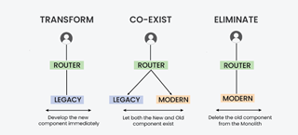
Strangler Pattern in Micro-services
The Strangler pattern is an architectural approach employed during the migration from a monolithic application to a microservices-based architecture. It derives its name from the way a vine slowly strangles a tree, gradually replacing its growth. Similarly, the Strangler pattern involves replacing parts of a monolithic application with microservices over time.
In order to implement strangler pattern, we need to follow 3 steps that are as follows:
Transform
Co-exists
Eliminate

Slide 60
Use Cases for the Strangler Pattern:
The Strangler pattern is primarily used when migrating from a monolithic architecture to microservices. It proves beneficial in scenarios where complete system rewrites pose significant risks and disruptions. This pattern is particularly suitable for legacy systems with complex codebases that are challenging to refactor entirely.

Slide 61
Features of the Strangler Pattern:
Gradual Migration: This pattern enables a step-by-step migration from a monolithic application to microservices. It allows organizations to replace specific functionality or modules incrementally.
Coexistence: During the migration process, the monolithic application and microservices coexist, ensuring uninterrupted system functionality.
Strangling Behavior: The Strangler pattern gradually replaces components or modules of the monolithic application with microservices, leading to the eventual replacement of the legacy system.

Slide 62
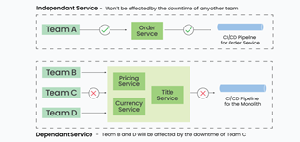
Implementation of Strangler Pattern:
Consider an e-commerce application with a monolithic architecture. To migrate the order management functionality to microservices using the Strangler pattern, follow these implementation steps:
Identify the order management functionality within the monolithic application.
Create an order management microservice.
Configure the API gateway to route order management requests to the microservice.
Migrate specific functionalities from the monolithic application to the microservice.
Repeat steps 1-4 until the monolithic application is fully replaced.

Slide 63
Advantages of Strangler Pattern
Incremental Migration: This pattern mitigates risks associated with complete system rewrites and minimizes disruptions by allowing a gradual migration process.
Flexibility: Organizations can independently refactor and update specific parts of the system based on business priorities.
Coexistence: The monolithic application and microservices coexist harmoniously, ensuring the system remains operational during the migration.

Slide 64
Drawbacks of Strangler Pattern
Complexity: The migration process can introduce complexity due to the coexistence and interaction between the monolithic application and microservices.
Data Consistency: Synchronizing data between the monolithic application and microservices can pose challenges, requiring careful management to ensure consistency.
Increased Network Calls: The introduction of microservices can lead to an increase in network calls, potentially impacting system performance and latency.
Dependency Management: Managing dependencies between the remaining monolithic components and new microservices requires proper versioning and dependency strategies to avoid conflicts.

Slide 65
Which components should be strangled or refactored first?
Playing it safe and choosing a straightforward component is not a bad choice if you are using the Strangler Pattern for the first time and are unfamiliar with this design pattern. This will make sure that before creating a complex component, you get real-world experience and familiarize yourself with the difficulties and best practices.
Starting with a component that has strong test coverage and little related technical debt can provide Teams a great deal of confidence during the migration process.
Start with a component that has scalability needs if there are any that are better suited for the cloud.

Slide 66
Which components should be strangled or refactored first?
Start with a component that needs to be deployed much more frequently due to frequent business requirements if there is one. You won't need to frequently again deploy the full monolithic application . You can scale and deploy the application independently if you divide it into a distinct process.
You will face numerous obstacles on your journey to migrate to the cloud. Due to the fact that you are dealing with small components at once, the Strangler design pattern helps you to make this journey somewhat smooth and risk-free. When you intend to complete the move in bits and pieces, it is not a difficult task.
You can provide Business features faster by reducing the complexity of an application. You may scale your application using the rising load feature as well.It is significantly simpler to deploy microservices and can result in a much smoother transition from monoliths to microservices if there is an automated CI/CD pipeline.

Slide 67
Event Sourcing

Slide 68
What is Event Sourcing?
The Event Sourcing Pattern is like keeping a detailed diary for your software. Instead of just updating the current state of your data, you record every change as a separate event. These events form a complete history of what happened to your data over time. Therefore, you may rebuild your data by replaying these events to find out how it got to where it is now.
These events are stored sequentially, forming a log or journal of actions that have occurred.
The status of the program can be restored at any moment by replaying these events.
It is frequently utilized in fields like finance and e-commerce where precise historical data are essential.

Slide 69
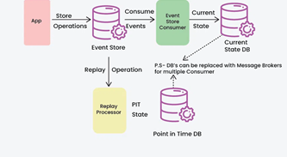
Event Sourcing

Slide 70
Core Concepts and Components of Event Sourcing
Events: These are permanent records of system state changes. In addition to representing a particular action or occurrence, each event includes all the relevant information required to rebuild the system's state at the moment of the event.
Event Store: The stream of events produced by the system is sustained by the event store, a robust data store. It guarantees that the sequence of events is maintained by storing them in the order in which they were received.
Aggregate: For the purposes of processing commands and producing events, an aggregate is a logical collection of linked domain objects that are handled as a single unit. The system's state changes and business logic are contained in aggregates. In the event store, each aggregate is linked to a distinct stream of events.

Slide 71
Core Concepts and Components of Event Sourcing
Command: Clients or other system components can issue commands, which are requests or instructions to carry out particular tasks. Aggregates process commands by validating them, applying business logic, and, if the command is approved, generating the appropriate events.
Projection: Projections are read models created from the stream of events kept in the event store that shows the system's current state. Projections are used to give effective access to data for reporting and querying.
Event Bus: An event bus is a messaging infrastructure that makes it easier for various system components to communicate about events. It enables components to respond asynchronously to particular event types and subscribe to them.

Slide 72
How Event Sourcing Pattern works?
Capture Events Instead of State: Every system modification is documented as an event (e.g., “order created,” “item added,” “order completed”) rather than just preserving the final state (e.g., “order is completed”). Every event denotes a distinct action or modification.
Store Events in Sequence: All events are stored in a sequence (often in a database or event store) in the exact order they occurred. This sequence of events acts as the "source of truth" for the system.
Reconstruct State by Replaying Events: When you need to know the current state, the system “replays” or processes all past events to build up the state from scratch.

Slide 73
How Event Sourcing Pattern works?
Handle New Events: As new changes happen, new events are created and added to the sequence. For instance, if an order is updated, a new event (e.g., “order updated”) is added to the sequence without changing or removing past events.
Replay Events for Debugging: If you need to see the history or investigate an issue, you can replay events to see how the state evolved over time. This replay ability makes it easy to understand the sequence of actions taken and trace any errors or issues.

Slide 74
Example of Event Sourcing Pattern
Registration System Before Event Sourcing
In a traditional event registration system, user registrations and cancellations are handled using a direct approach where the state is updated immediately in the database. This can lead to challenges such as difficulty in tracking changes, loss of historical data, and issues in notifying users when their registration status changes.
Below is the traditional registration class in which there are several issues:
When users register or cancel their registrations, the system updates the database immediately without maintaining a history of actions.
The system does not record the reasons for registration changes, making it hard to audit past actions.
Notifications to users must be handled separately, leading to potential delays and errors in communication.

Slide 75
Example of Event Sourcing Pattern
public class Registration {
private RegistrationState state;
private String userId;
private String eventId;
public void register(String userId, String eventId) {
this.state = RegistrationState.REGISTERED;
this.userId = userId;
this.eventId = eventId;
// Update the database directly
Database.update(this);
}
public void cancel() {
this.state = RegistrationState.CANCELLED;
// Update the database directly
Database.update(this);
}
}
In the code, When a user registers or cancels, the state is directly updated in the database, which may cause inconsistencies if issues arise during processing. Notifications to users are not integrated with the registration process, which may lead to missing or delayed alerts.

Slide 76
Example of Event Sourcing Pattern
2. Registration System Using Event Sourcing
With the move to an event-sourced architecture, the system now records each significant change as an event, allowing better tracking and historical analysis.
Instead of directly updating the database, the system processes commands to create and cancel registrations and generates events for each action.
Each state change is represented by an event, providing a clear audit trail of user actions.
Notifications are handled through event subscribers, ensuring users are promptly informed about their registration status changes.

Slide 77
Example of Event Sourcing Pattern
public class Registration extends ReflectiveMutableCommandProcessingAggregate<Registration, RegistrationCommand> {
private RegistrationState state;
private String userId;
private String eventId;
public RegistrationState getState() {
return state;
}
public List<Event> process(RegisterForEventCommand cmd) {
return EventUtil.events(new EventRegisteredEvent(cmd.getUserId(), cmd.getEventId()));
}
public List<Event> process(CancelRegistrationCommand cmd) {
return EventUtil.events(new RegistrationCancelledEvent(userId, eventId));
}
public void apply(EventRegisteredEvent event) {
this.state = RegistrationState.REGISTERED;
this.userId = event.getUserId();
this.eventId = event.getEventId();
}
public void apply(RegistrationCancelledEvent event) {
this.state = RegistrationState.CANCELLED;
}
}
By transitioning to an event-sourced architecture, the event registration system gains a clear advantage in tracking registration states, maintaining a complete history of actions, and ensuring timely notifications to users.

Slide 78
Benefits of Event Sourcing Pattern
By recording all system modifications, Event Sourcing builds an unalterable record of all activities.
With event sourcing, you can replay events up to a certain point in time to query the system's current state.
Event sourcing encourages adaptability and system development over time. New event types can be created to address changes in business requirements without affecting current components.
Event Sourcing is a good fit for distributed systems and horizontal scaling as events can be individually consumed and processed by several components, enhancing scalability and speed.

Slide 79
Challenges with Event Sourcing Pattern
Events may take on a different structure as the system develops. It becomes essential to manage event versioning and backward compatibility to guarantee seamless migrations and upgrades without erasing previous data.
It can be difficult to properly store and retrieve huge amounts of events, particularly in situations with high throughput or lengthy event histories. It becomes crucial to put in place efficient querying and event storing systems.
Various components of the system may see state changes at various times due to eventual consistency, which is usually the outcome of event sourcing. Handling stale data, resolving conflicts, and data synchronization all need careful thought when dealing with eventual consistency.

Slide 80
Use Cases and Applications of Event Sourcing
Financial Systems: To keep an unchangeable record of transactions, account activity, and compliance events, banking and financial institutions use event sourcing.
Healthcare Records: Electronic health record (EHR) systems use event sourcing to document patient contacts, treatment histories, and medical procedures.
Supply Chain Management: Event sourcing is used in supply chain and logistics management to track inventory movements, shipping updates, and supply chain interruptions.
E-commerce Platforms: Event sourcing is a useful tool for e-commerce applications to record customer interactions, order fulfillment processes, and inventory changes. This makes it feasible to track orders, offer customized recommendations, and examine customer behavior in order to boost sales and customer satisfaction.
Gaming and Virtual Environments: Event Sourcing is used in virtual worlds and multiplayer online games to record player movements, game state changes, and in-game purchases.

Slide 81
Real-World Example of Event Sourcing Pattern
Account Operations: The system creates related events whenever a consumer does an action that impacts their account, like making a deposit, taking money out of their account, moving money to another account, or changing personal data.
Event Logging: elevant details including the kind of operation, the amount involved, timestamps, and any additional metadata required to recreate the account's status are contained in each event.
Event Processing: These events are consumed by event handlers or processors, who then alter the status of the impacted accounts appropriately. For instance, the account balance is increased if a "Deposit" event is noted. The balance is reduced if a "Withdrawal" event is recorded.
Scalability and Resilience: Event Sourcing distributes event processing over several nodes, enabling the bank's system to scale horizontally. The system can recover by replaying events from the event storage to restore the status of accounts in the event of malfunctions or outages.

Slide 82
When to Use Event Sourcing Pattern
It's good for apps with complicated rules that need to keep track of how things change over time.
It helps when you need a complete history of changes for legal reasons or audits.
Useful for systems that need to save old data, like financial information.
Helps your app bounce back quickly from problems by replaying past events.
Works well in systems with separate parts (like microservices) that need to communicate without being tightly linked.

Slide 83
When not to Use Event Sourcing Pattern
Simple Applications: If an application just needs to track the most recent state and doesn't require a thorough history or audit trail, Event Sourcing may introduce needless complexity.
High Storage Costs: Event Sourcing stores every change as an event, which can lead to high storage costs, especially if there are frequent updates or changes.
Complex Data Consistency Needs: Managing consistency across multiple events can become challenging, especially when coordinating data between different services or systems.
Performance Sensitivity: Replaying events to rebuild the state can slow down performance in applications where quick data retrieval is essential.

